Slide 1
Project 12
Air pollution prediction in Beijing
Charottama Oshmar D., 6599126, 20%
Lakshmi Ramesh, 6125555, 20%
Saruul Bayarsaihan 6698694 20 %
Daniil Nikonenko 5032453 20%
Prabhath Darshana Nakandalage Don, 5995401, 20%

Slide 2
Preprocessing and Visualizations

Slide 3
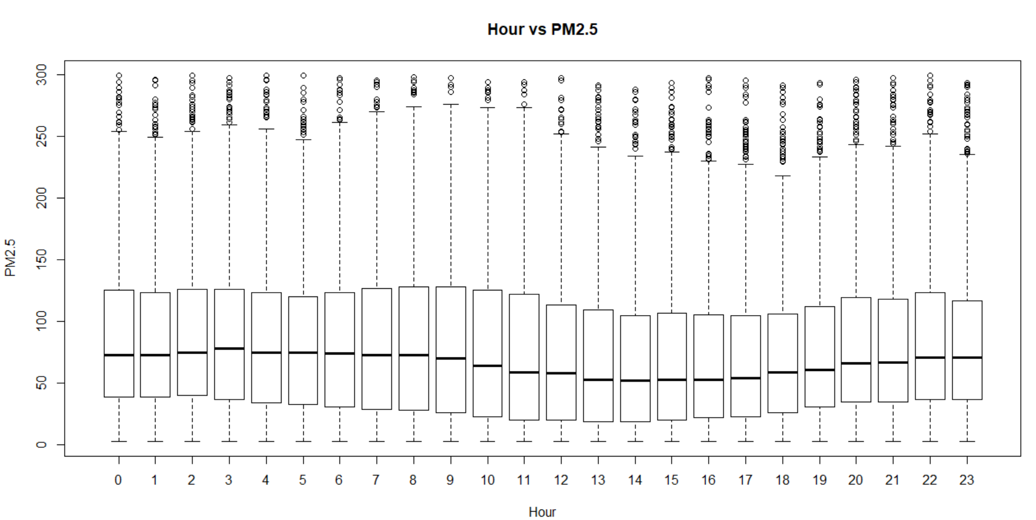
Plots

Slide 4
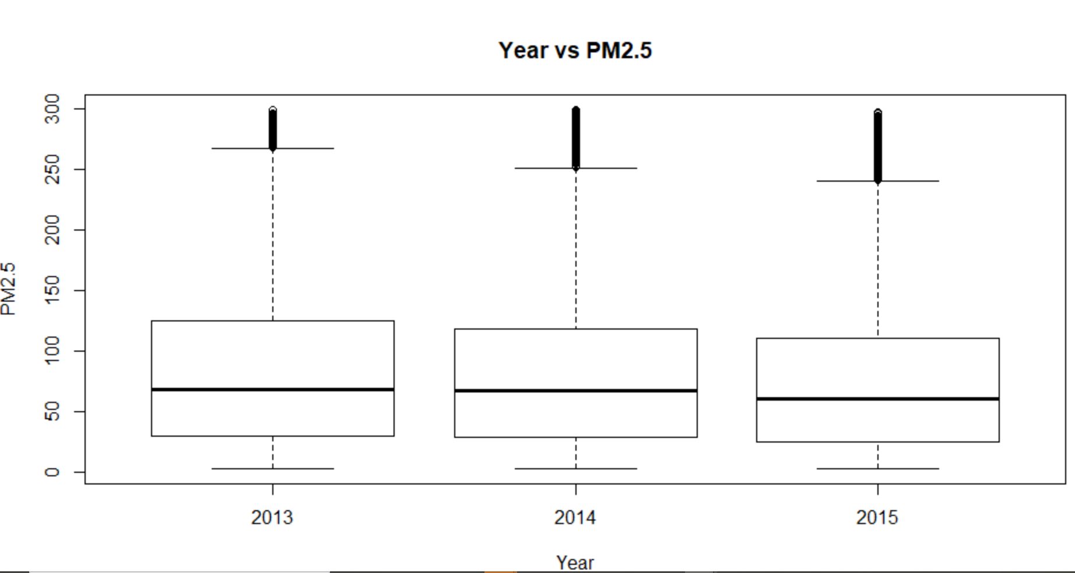
Plots

Slide 5
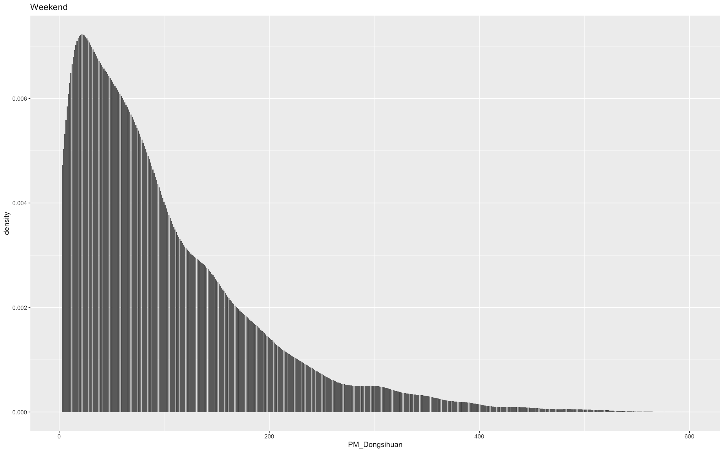
Plots

Slide 6
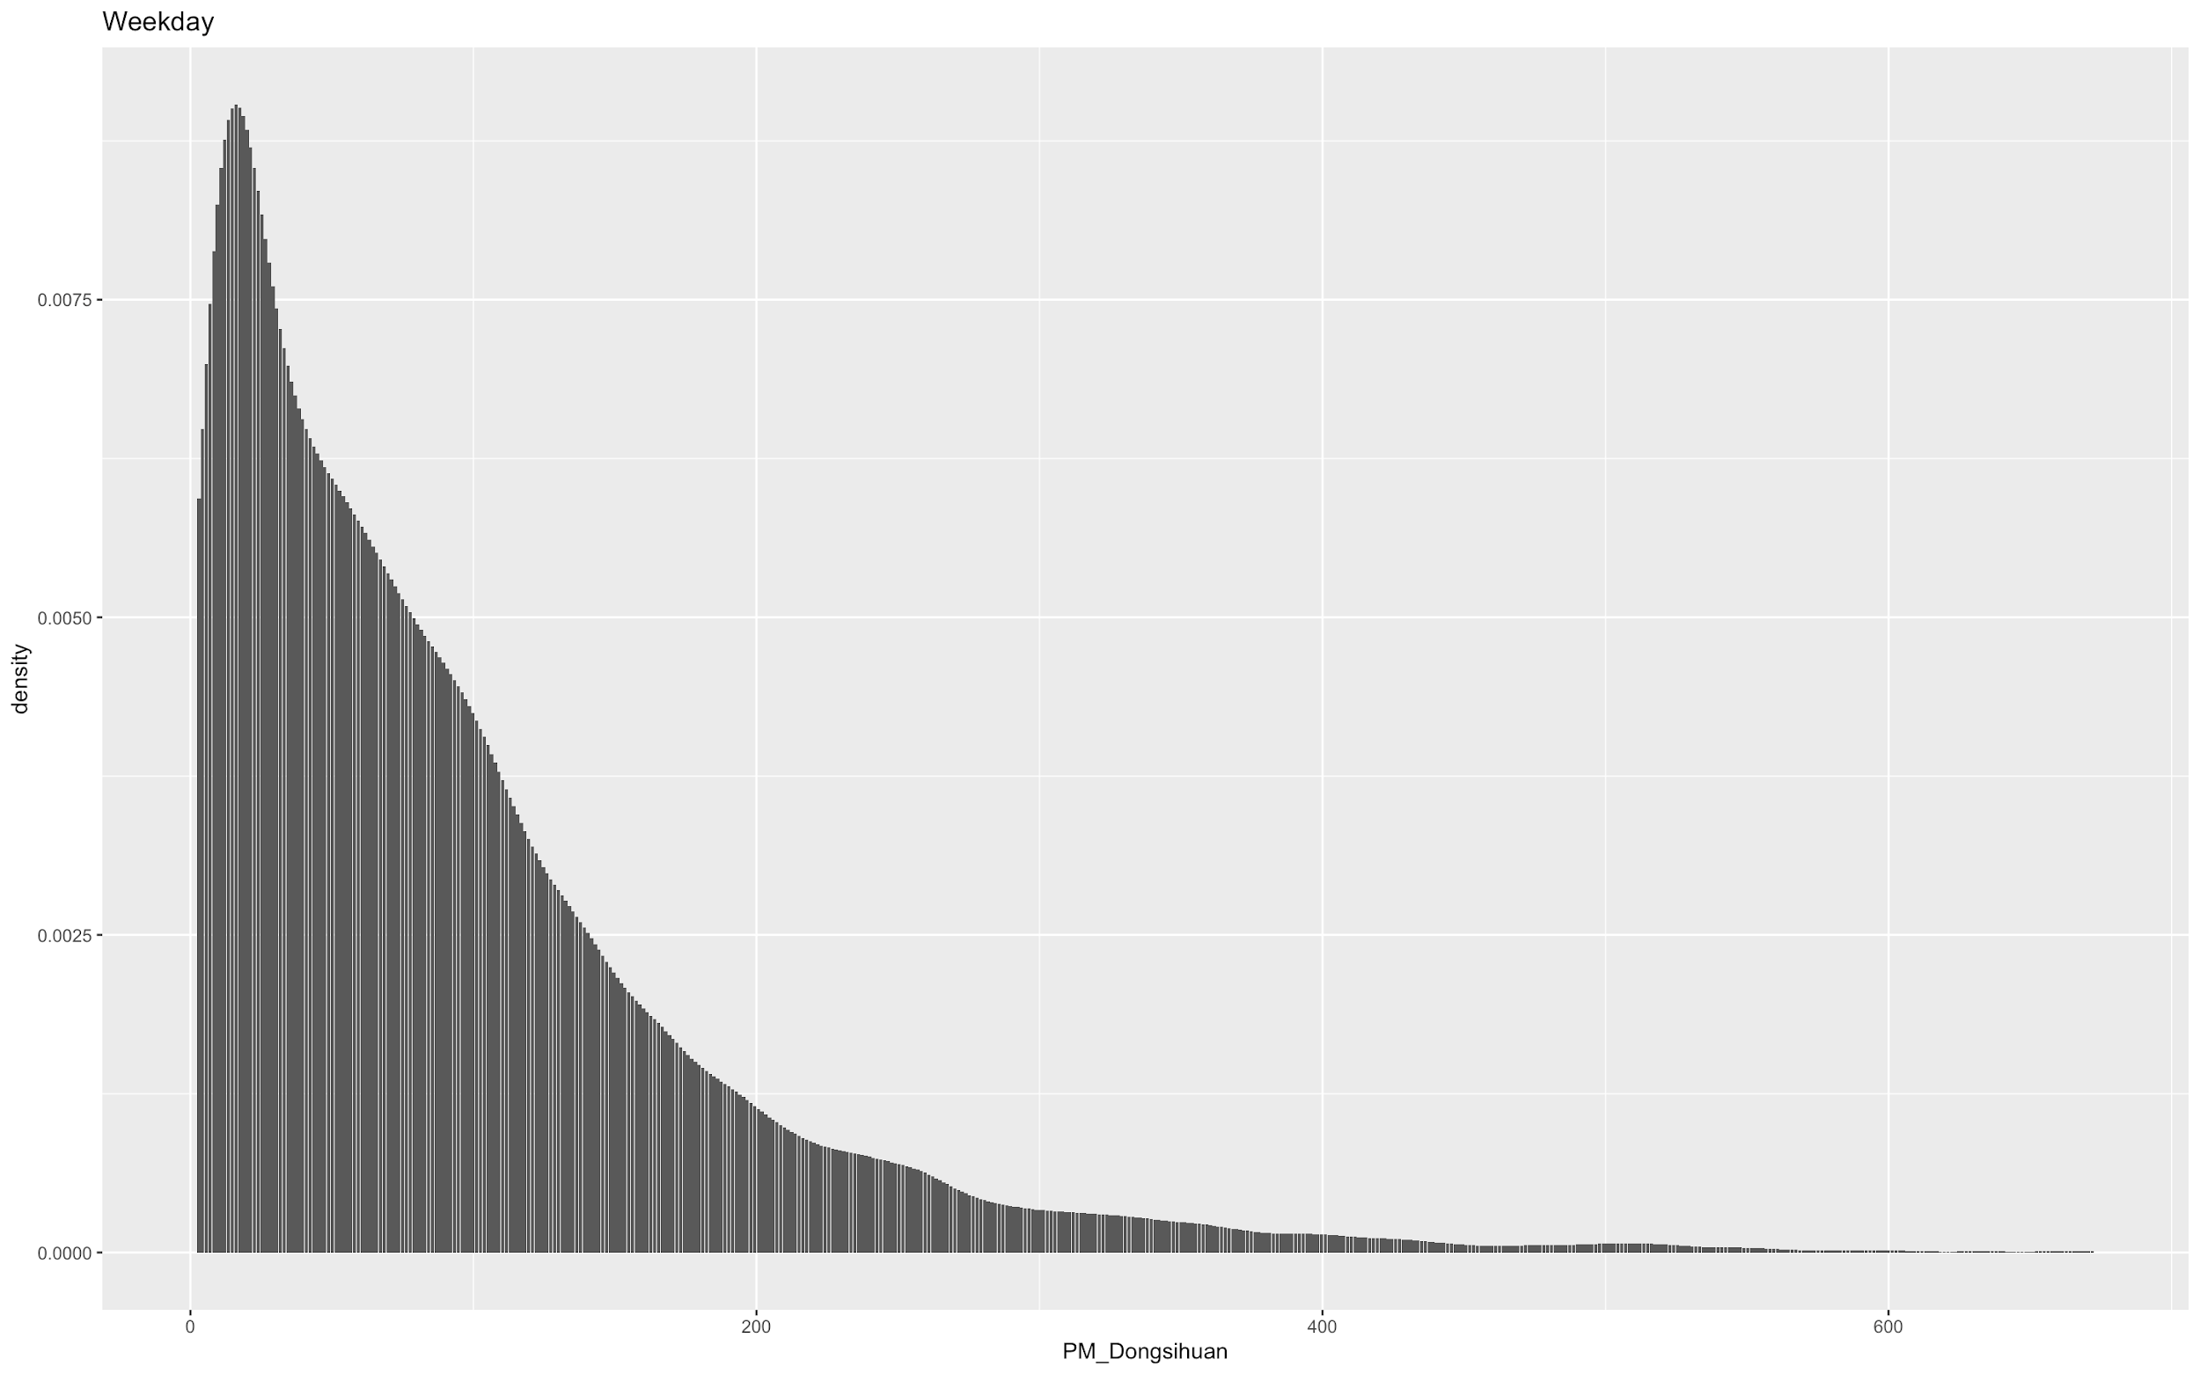
Plots

Slide 7
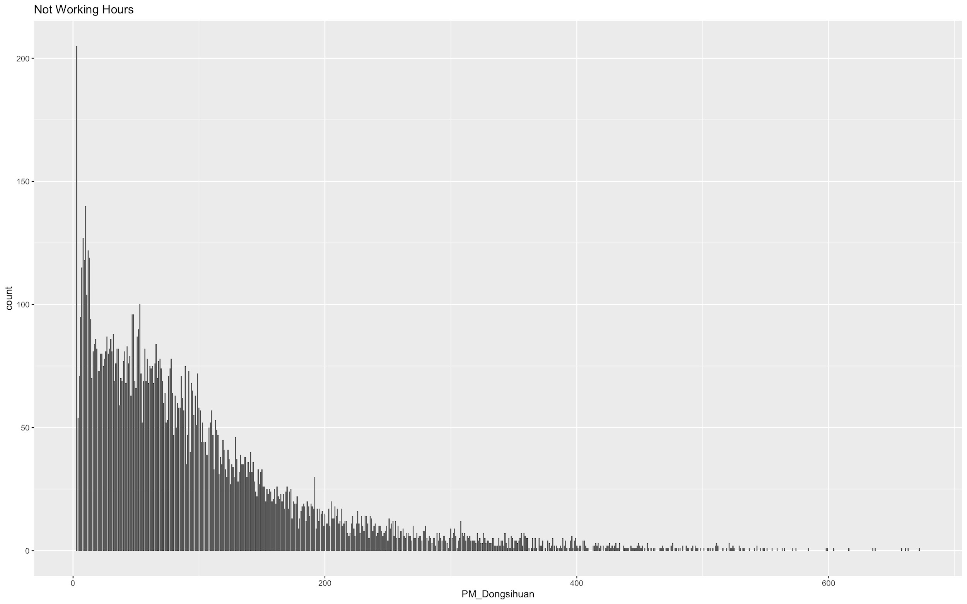
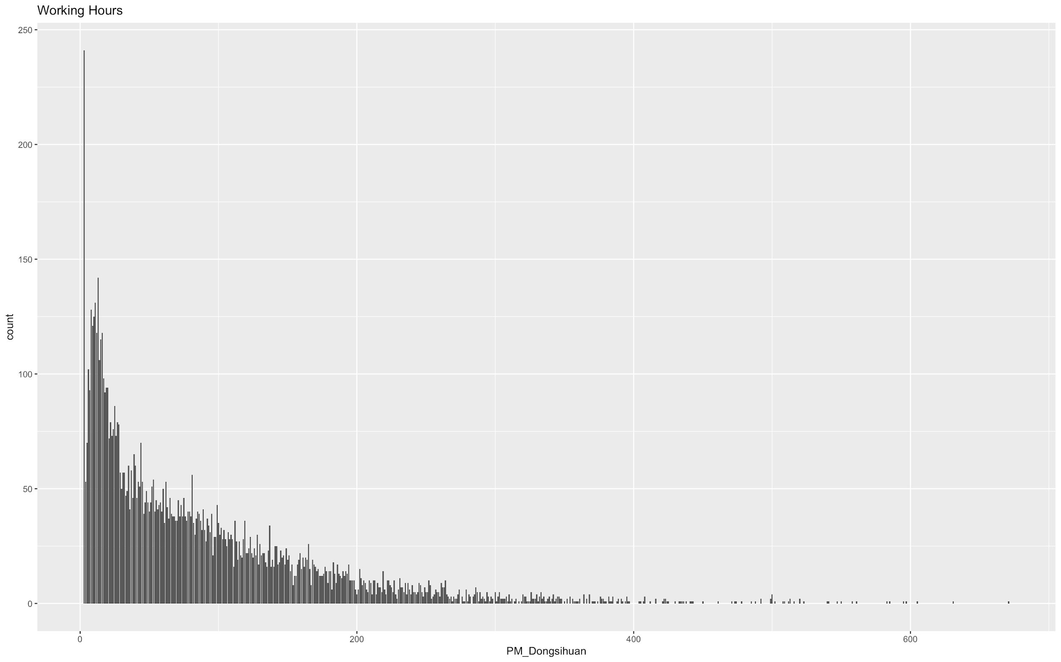
Plots

Slide 8
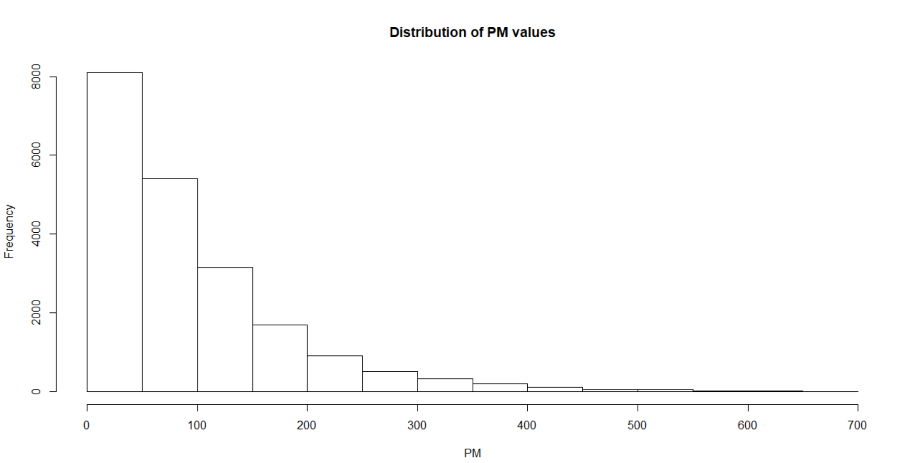
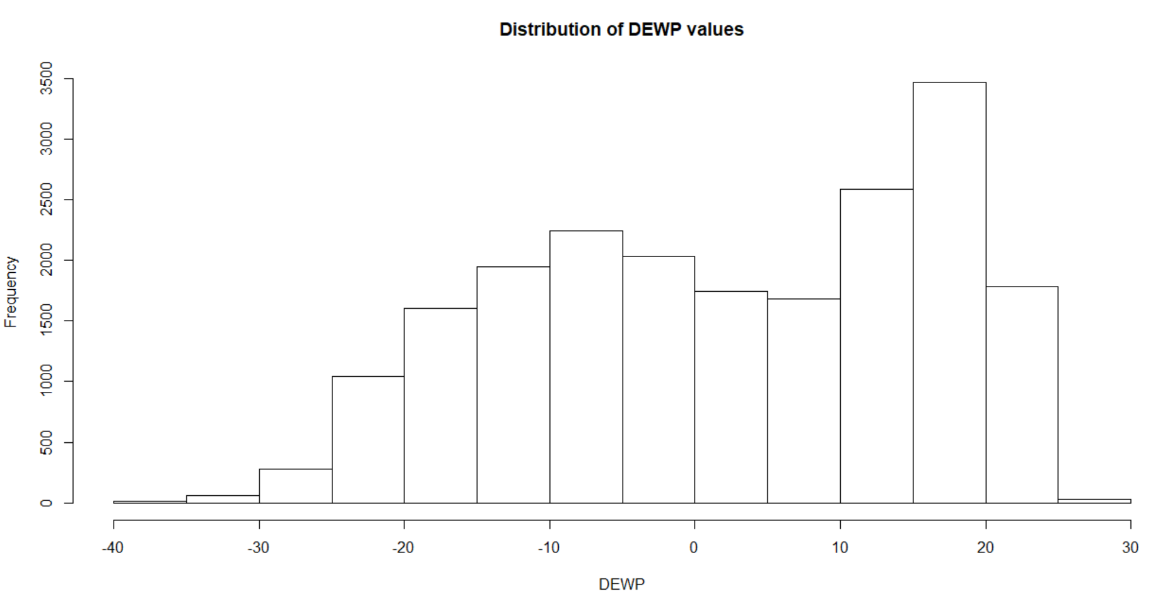
Histograms

Slide 9
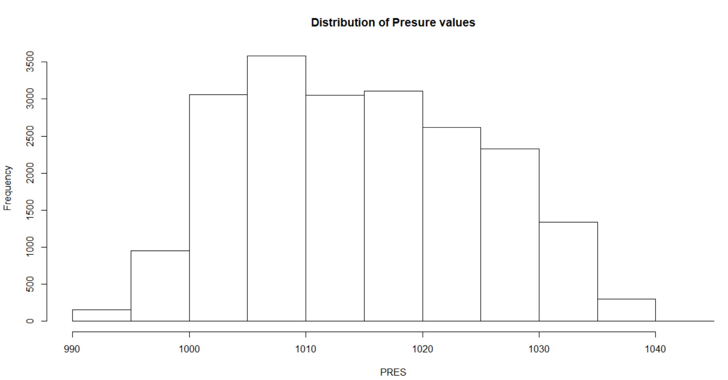
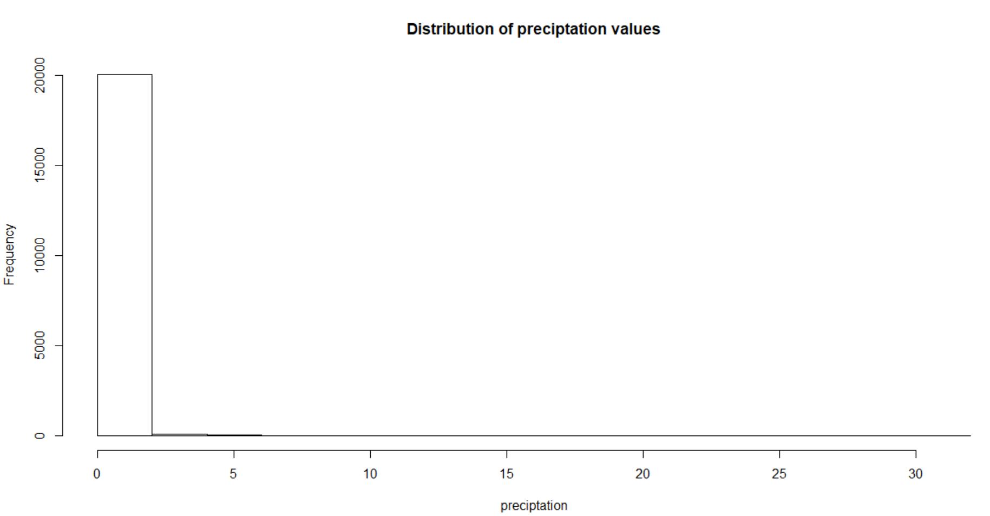
Histograms

Slide 10
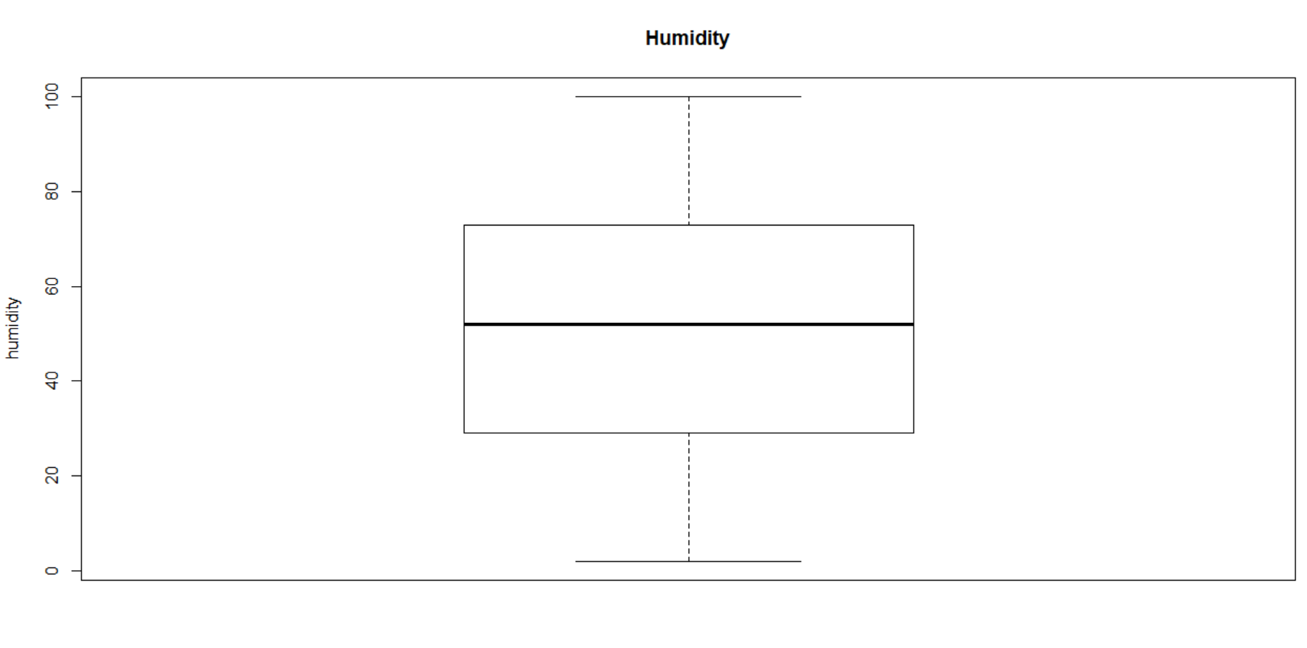
Box Plots

Slide 11
Data Preprocessing
Remove rows with missing values
Remove columns which has less variation
Remove the “No” column
Add new columns to identify weekdays and work hours
Convert columns to factors and ordered depending upon its data
Factors : Weekend, work hour, season,
Ordered : Year, month, day,hour
Filter out outliers
Remove rows with PM2.5 values < 300
Remove rows with DEWP > -30 & DEWP<25
Remove rows with PRES > 995 & PRES<1035
Divide dataset into train and test set.

Slide 12
Data Mining Approach, Strengths and Weaknesses, Performance

Slide 13
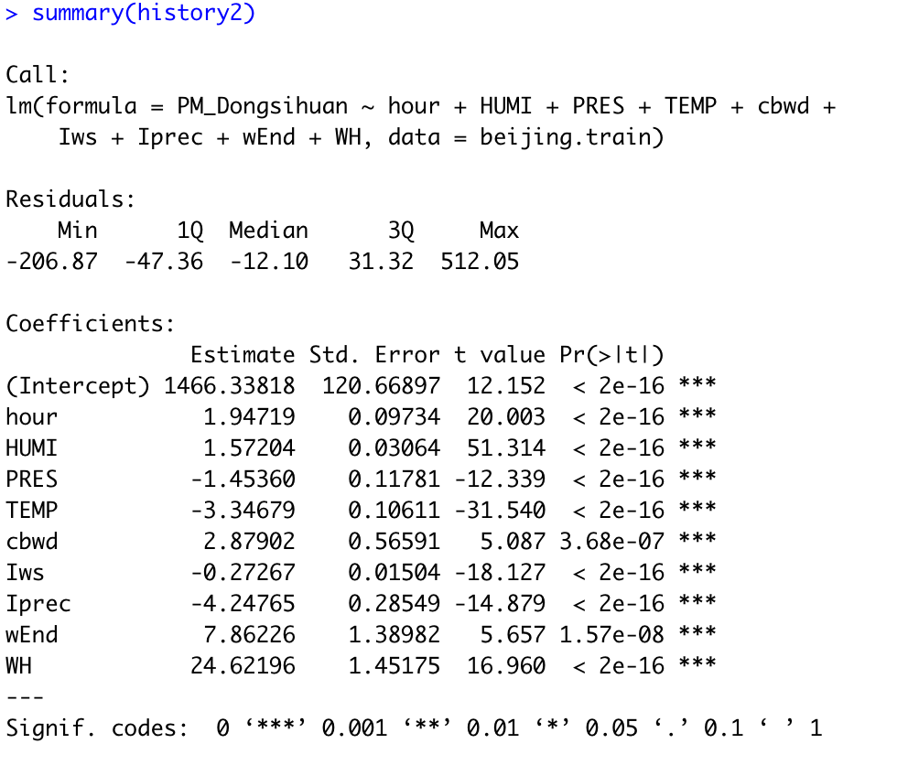
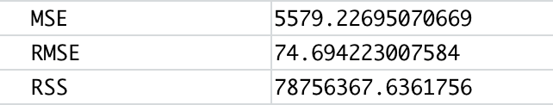
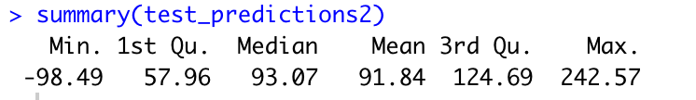
Standard Linear

Slide 14
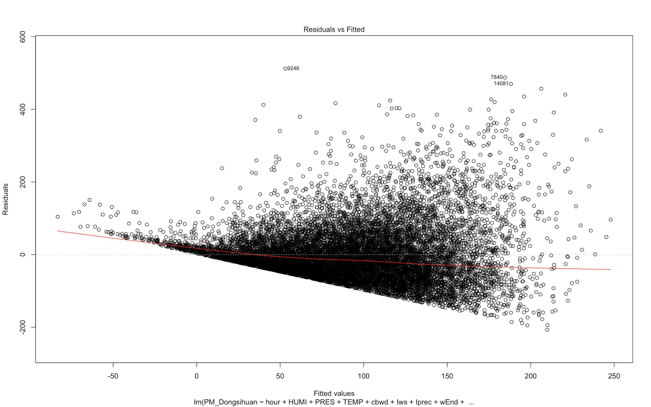
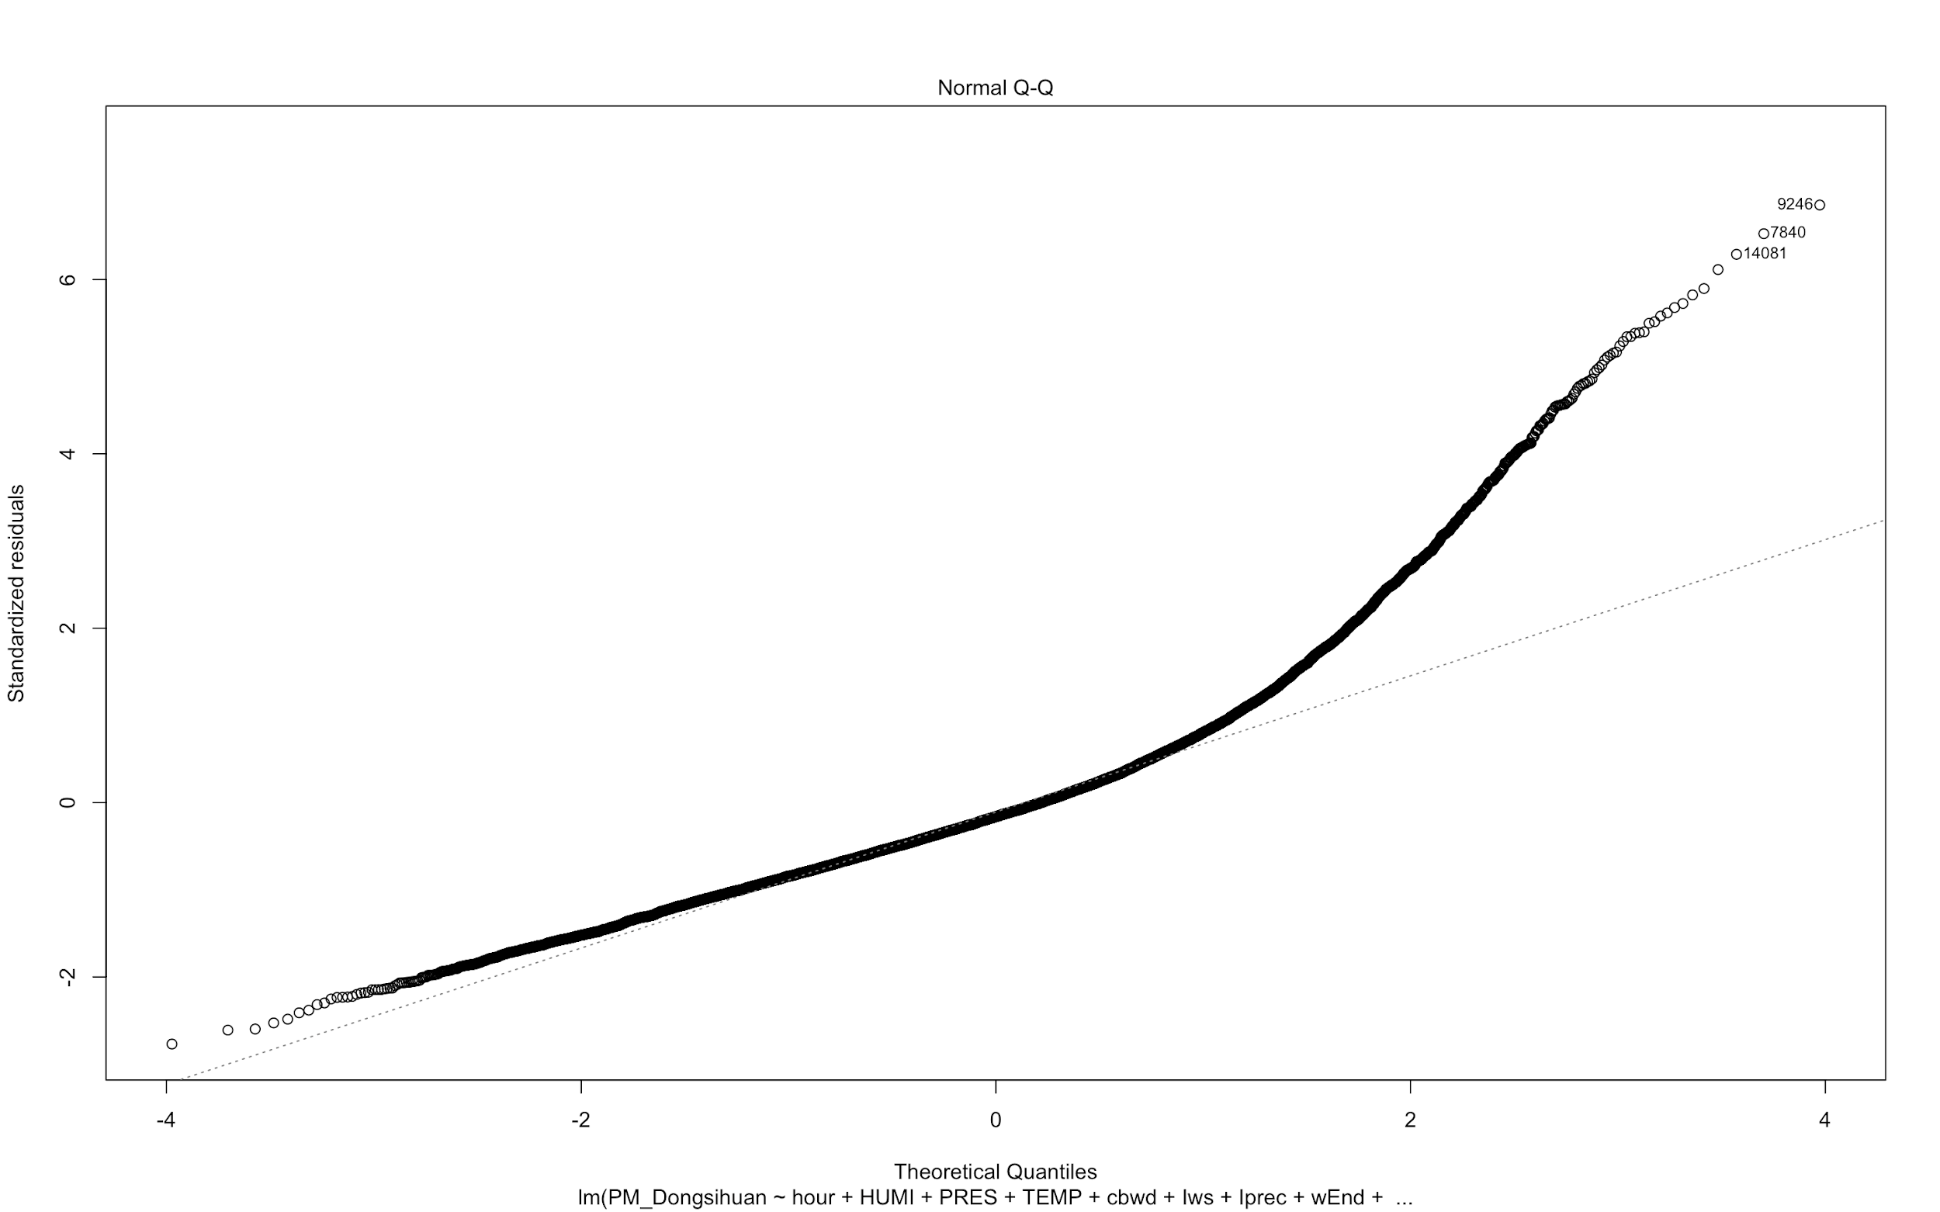

Slide 15
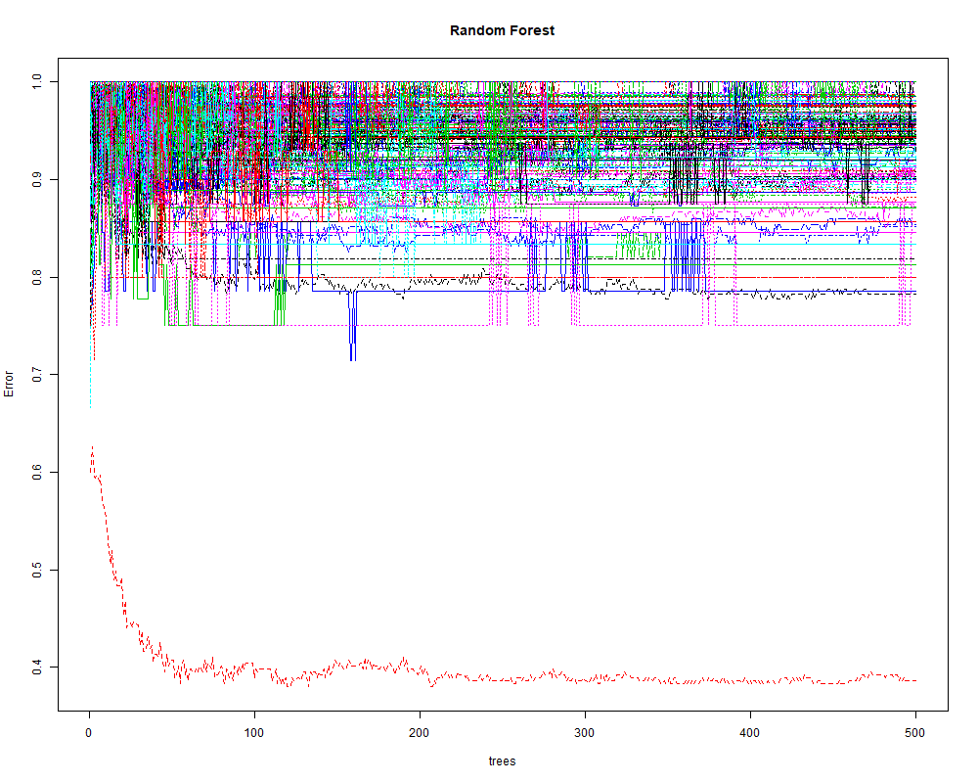
Random Forest
The construction of multiple decision trees at training is a Random Forest.
Random Forests are used for prediction, classification and regression.
Random Tree is used to predict PM_2 Pollution
The RSME value is 48.44141

Slide 16
Call:
randomForest(formula = PM_Dongsihuan ~ ., data = training_set, stepFactor = 1, ntree = 500)
Type of random forest: classification
Number of trees: 500
No. of variables tried at each split: 3
OOB estimate of error rate: 93.27%

Slide 17
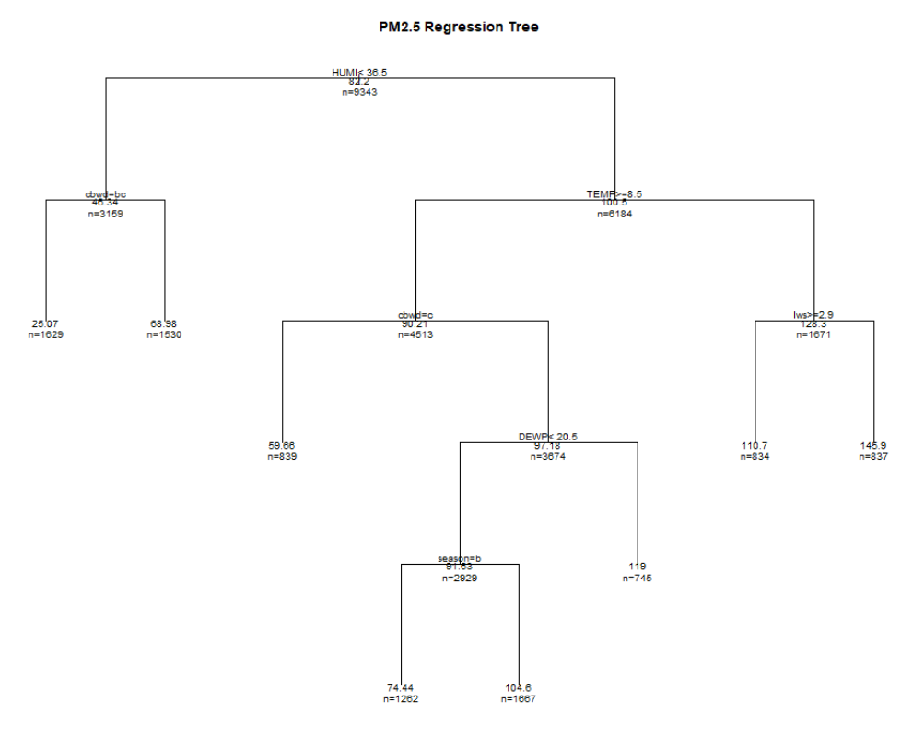
Regression Tree
A Decision Tree where target values can take continuous values is called a regression tree.
This Regression tree can predict the PM2.5 values of Dongsihuan
The lead nodes shows the PM 2.5 prediction
RMSE = 43.3128 on test set
Root Node uses HUMI values to branche at a cut off value 36.5

Slide 18
Rpart
> regTreeModel = rpart(PM_Dongsihuan ~ ., data = train_data)
> regTreeModel
n= 8810
node), split, n, deviance, yval
* denotes terminal node
1) root 8810 22908170.0 69.73723
2) HUMI< 39.5 3471 5892912.0 44.77557
4) cbwd=NE,NW 1699 1405088.0 24.45968 *
……………………………………………………………………………..

Slide 19
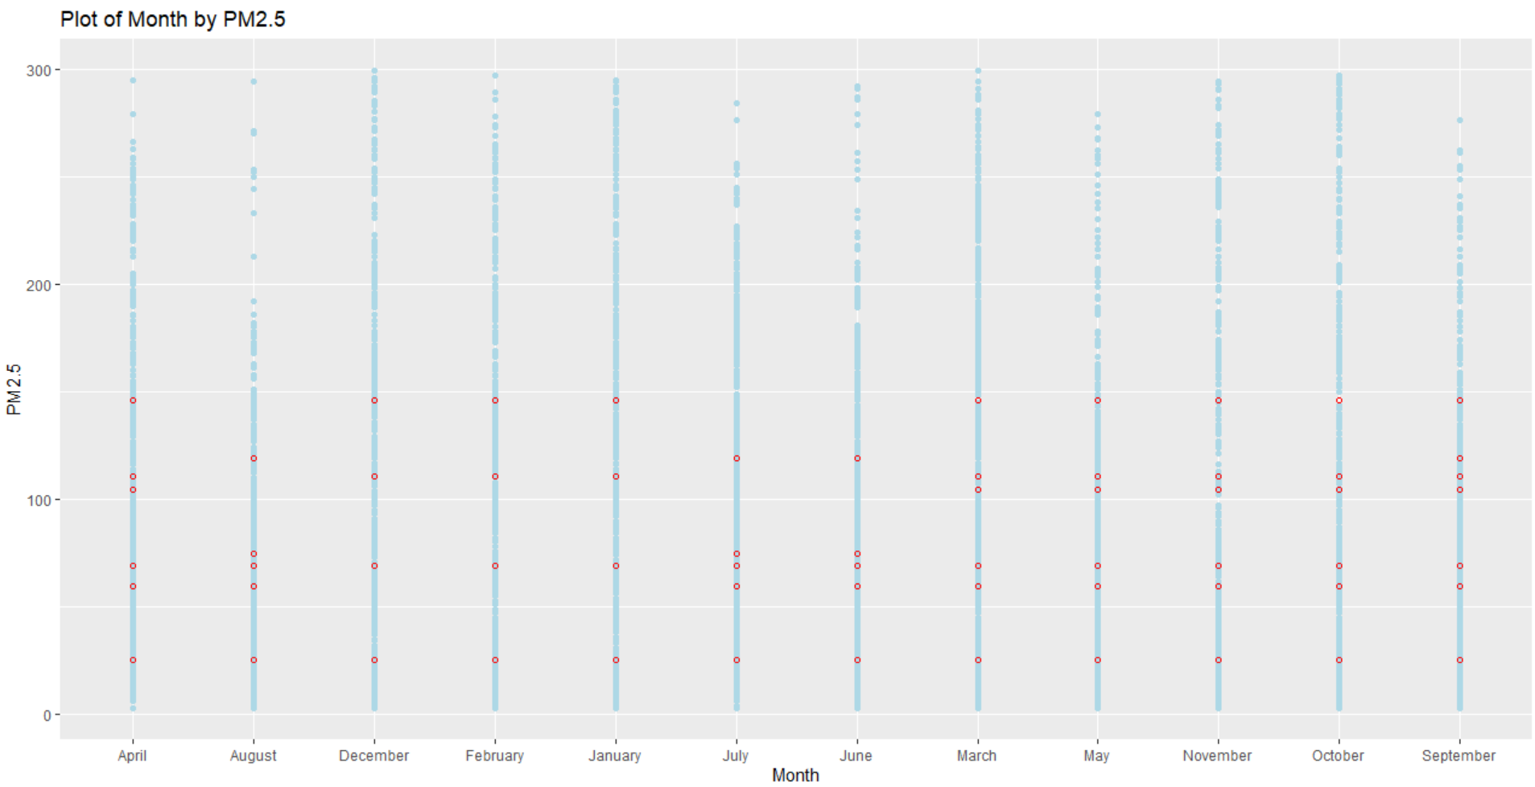
Actual Values
PRedicted Values

Slide 20
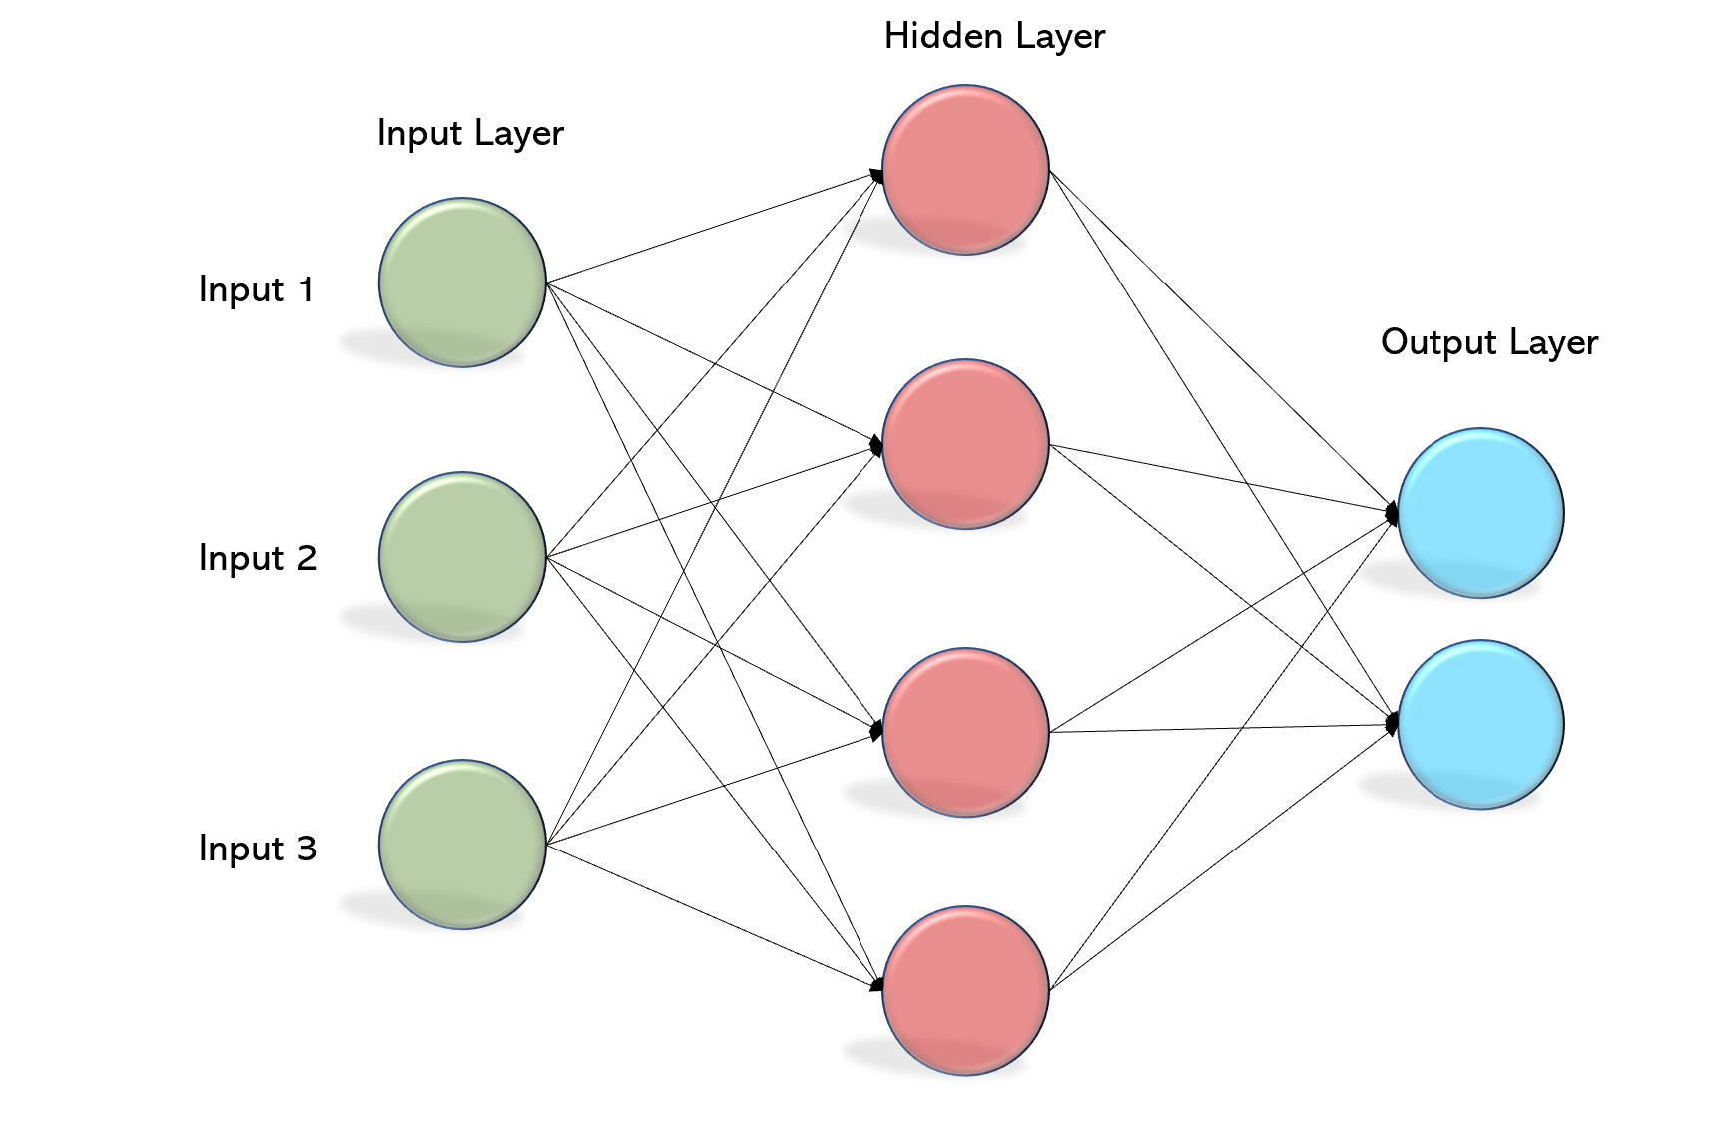
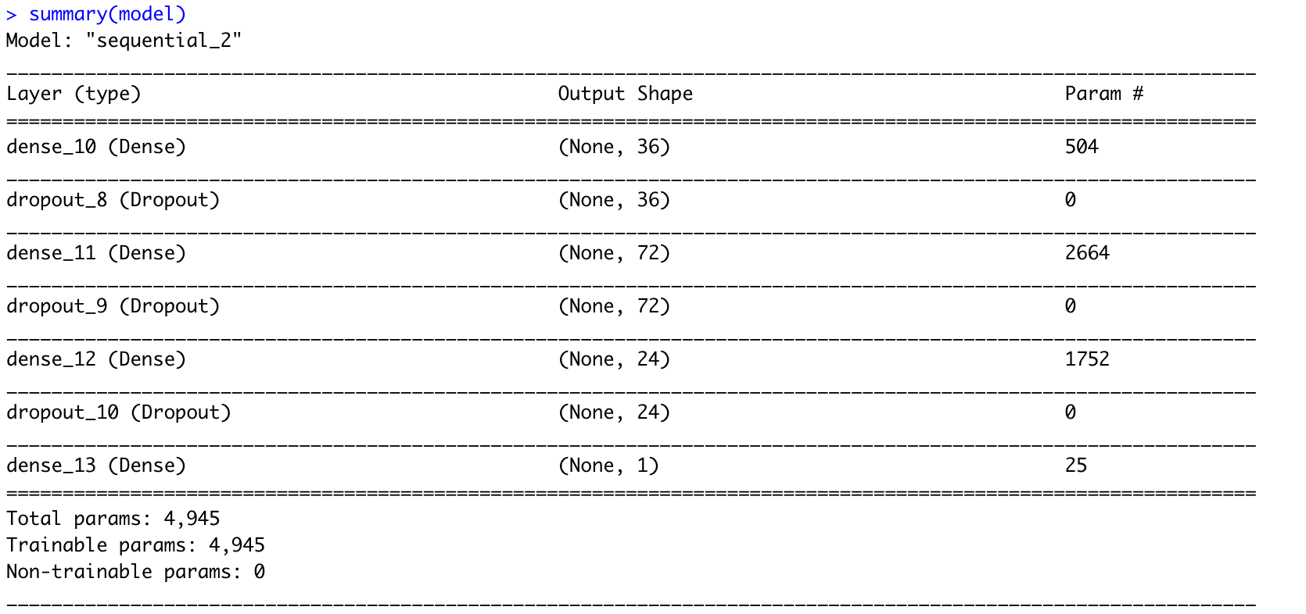
Multilayer Perceptron
Artificial Neural Network, works by principles of feedforward and backpropagation. General structure is 1 input layer, >= 1 hidden layer(s), 1 output layer
Automatically puts more ‘weights’ to important features
Add to model nonlinear, complex relationships
Can generalize
Distribution of does not affect very much
Computationally expensive (alleviated by GPU)
May get stuck in local minima
Notes:
How does MLP work? How does it adjust weights and biases?

Slide 21
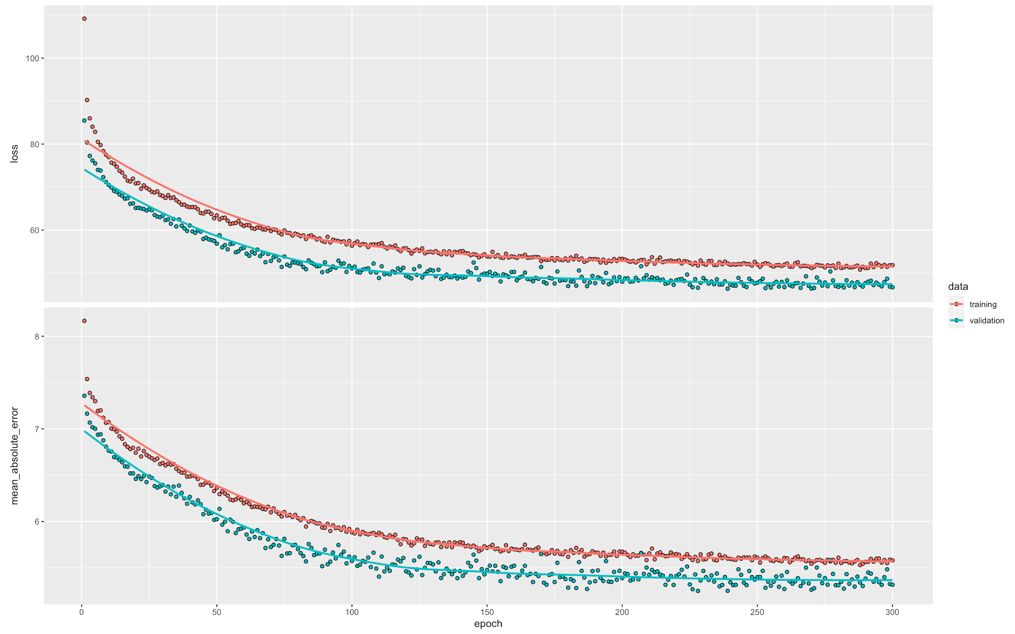
Notes:
For consistency, RMSE approx. = 7.07

Slide 22
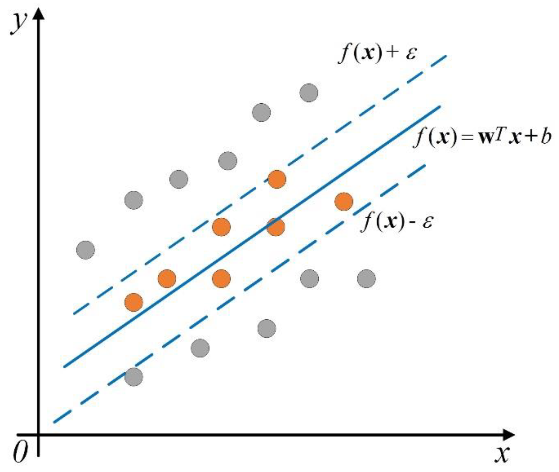
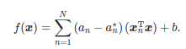
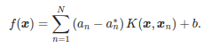
Support Vector Regression
A type of SVM for regression
The goal is to find a function f(x) that deviates from yn (sample labels)
Also known as Tube regression
Linear SVR
Nonlinear SVR
REFERENCE: https://www.mdpi.com/2076-3417/9/19/4069/htm
Notes:
Support vector regression is a type of svm that use for regression
The goal of SVR is to find a function f(x) that deviates from Yn (Sample labels) by a value no greater than ε (bias) for each training point x - That remain as flat as possible
Therefore this is also known as Tube regression method as shown in the figure
The linear SVR function denoted as follows
However not all problems are linear; Therefore we can change the xTx dot product with Kernel function K so that transformation that maps x to a high-dimensional space

Slide 23
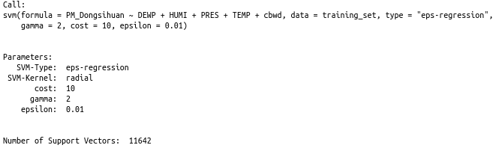
Support Vector Regression
RMSE: 41.85295
Notes:
This results shows the tuned parameters or support vector regression that has been finally used for training
The Root Mean Square Error (RMSE) value was 41.85295 which is little higher value compared to the data set

Slide 24
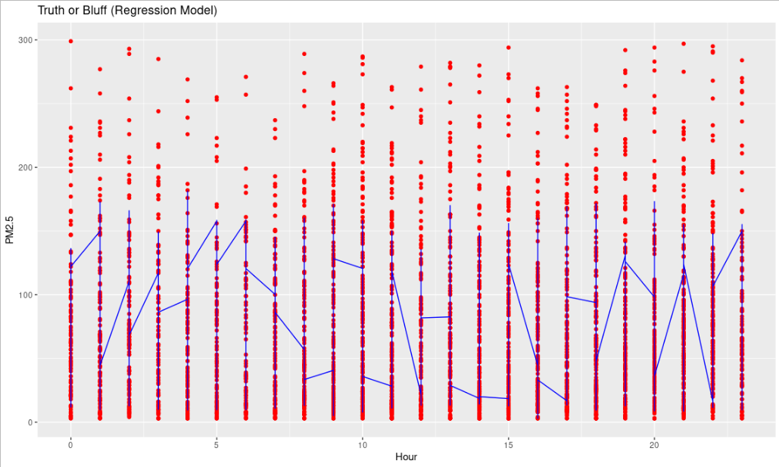
Support Vector Regression
Actual PM values
Predicted PM values
Notes:
The chart shows the map of actual PM values vs predicted PM values map according to hours
Red: Actual value
Blue line: Predicted value

Slide 25
Findings and Interpretations

Slide 26
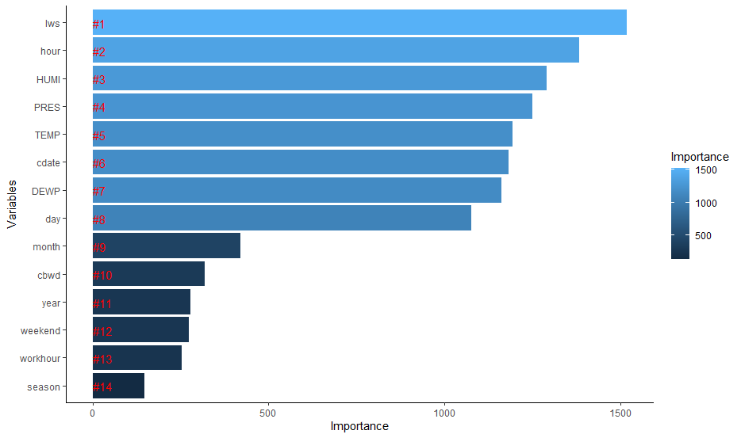

Slide 27
Model Performance Comparisons
Model | RMSE
Regression Tree | 43.31
SVR | 41.85
MLP | 7.07
Standard Linear Regression | 74.69
Random Forest | 48.44
Notes:
MLP shows the best results

Slide 28
Findings
Filter Threshold for PM_Dongsihuan (Removing all rows with PM value greater than this threshold) | RMSE
200 | 43.1328
300 | 55.8912
400 | 61.653

Slide 29
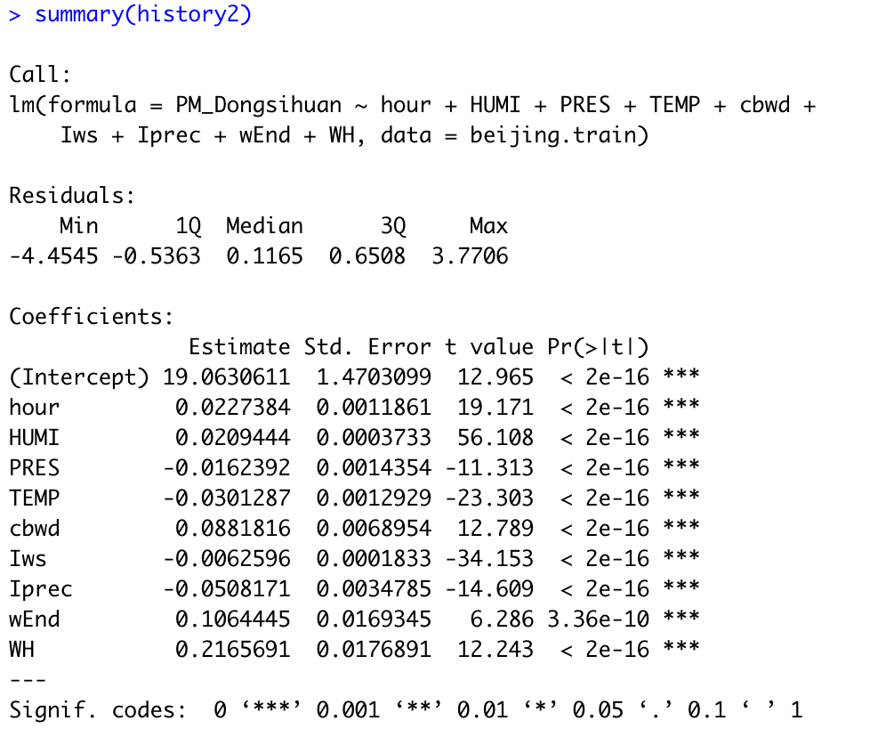
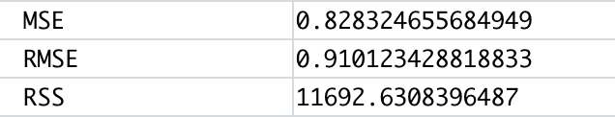
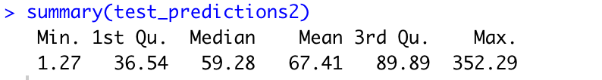
Using ln of PM_2.5 for Standard Linear

Slide 30
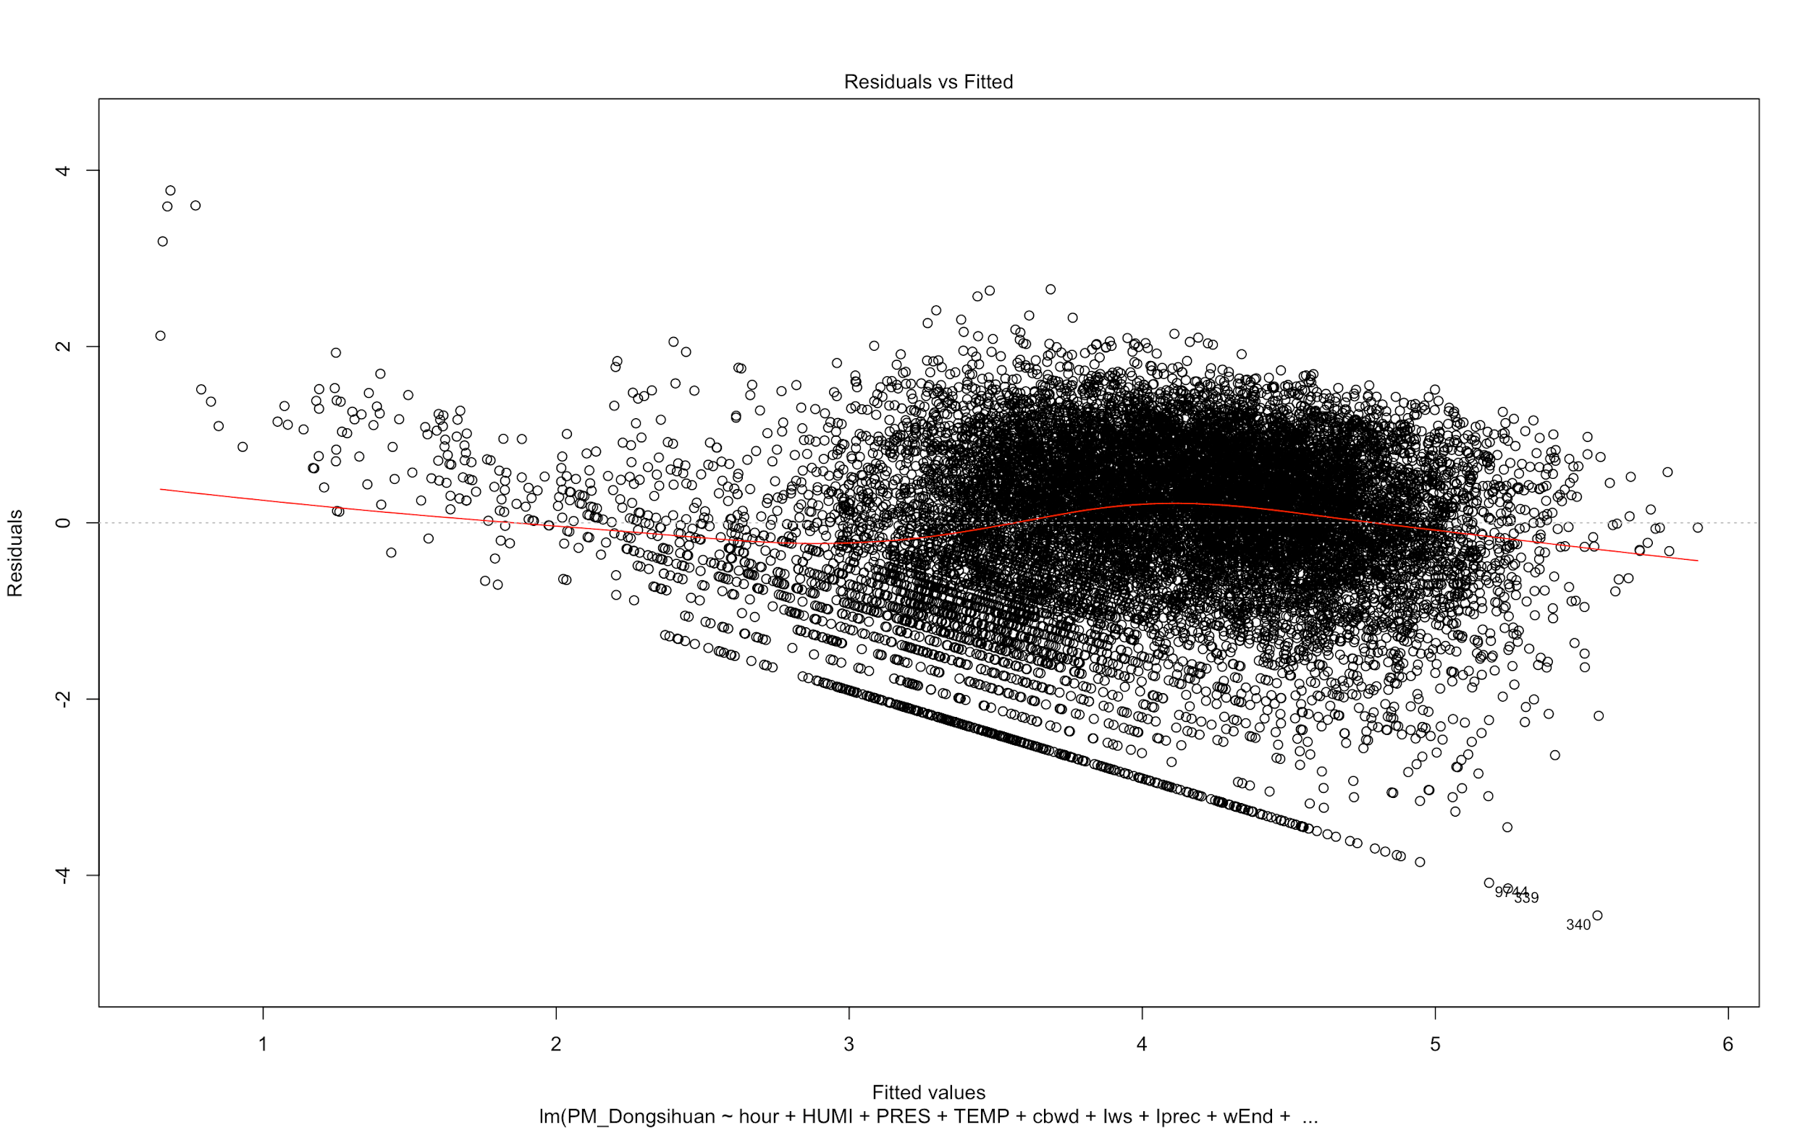
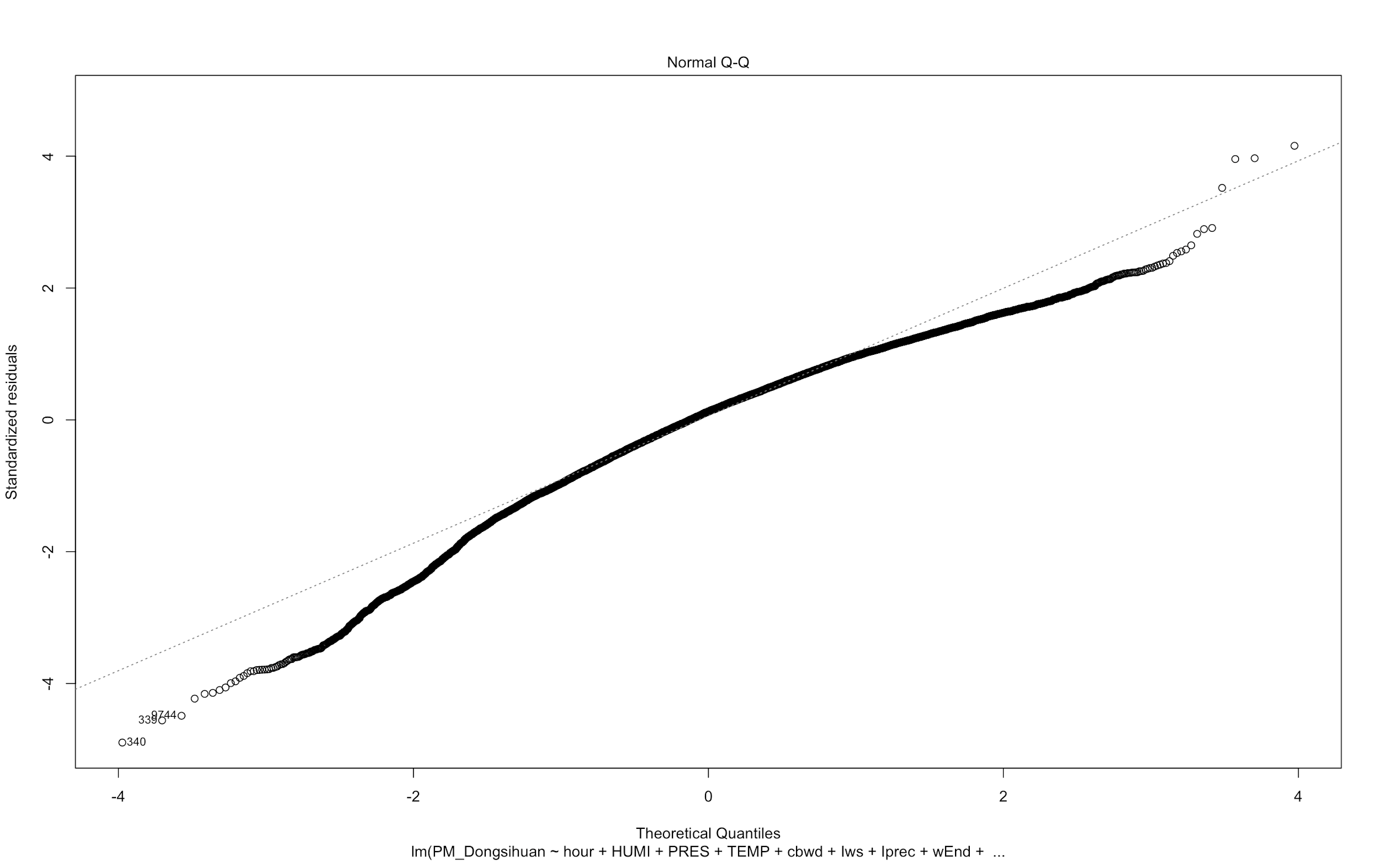
Using ln of PM_2.5 for Standard Linear

